Slide 1
Randomized Algorithms CS648
Lecture 18
Randomized Algorithm for Min-cut (part I)
Optimizing the number of random bits

Slide 2
Min-cut
A Randomized Algorithm

Slide 3



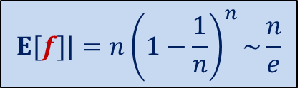


Graph and Multi-graph
A multi-graph may have:
More than one edge between a pair of vertices
No self loop
$$u$$
$$a$$
$$l$$
$$v$$
$$x$$
$$b$$
$$h$$
$$w$$

Slide 4

Min-Cut
$G=(V,E)$: undirected connected graph
Definition (cut):
A subset $C⊆E$whose removal disconnects the graph.
Definition (min-cut): A cut of smallest size.
Problem Definition: Design algorithm to compute min-cut of a given graph.

Slide 5

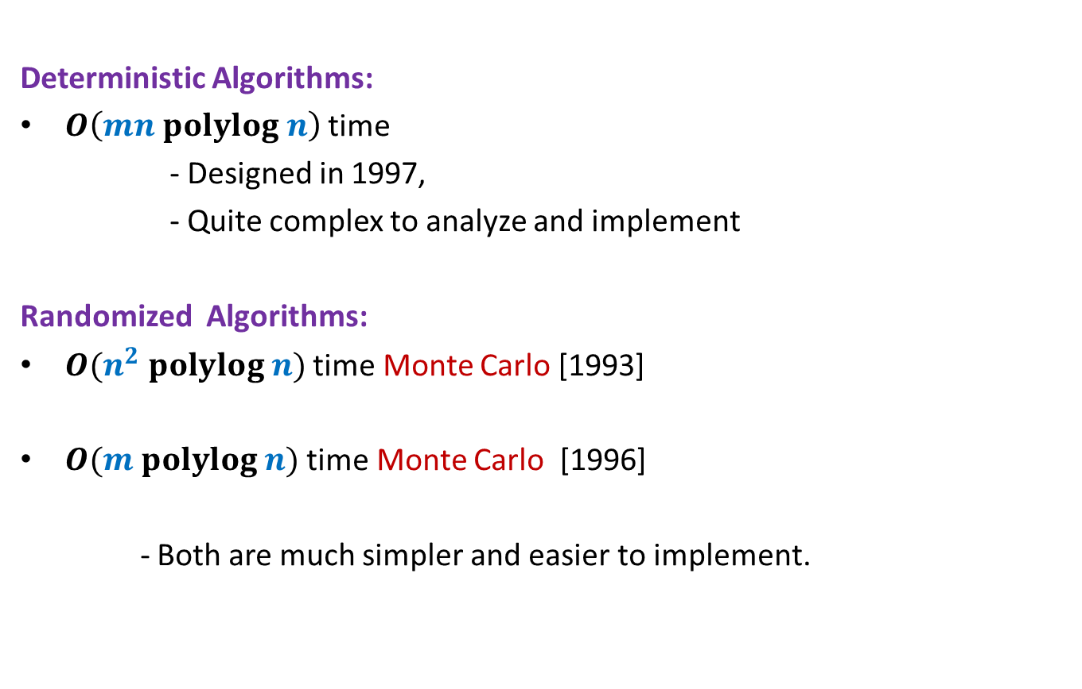
Min-Cut
Deterministic Algorithms:
$O\left(mn polylog n\right)$ time
- Designed in 1997,
- Quite complex to analyze and implement
Randomized Algorithms:
$O(n^{2} polylog n)$ time Monte Carlo [1993]
$O(m polylog n)$ time Monte Carlo [1996]
- Both are much simpler and easier to implement.
$O(m polylog n)$ time [2015]

Slide 6
some basic facts

Slide 7
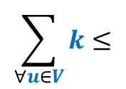
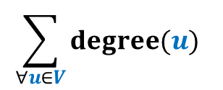





Min-Cut
Question: How many cuts ?
Answer: $\frac{2^{n}−2}{2}$
Question : what is relation between degree($u$) and size of min-cut ?
Answer: size of min-cut $≤$ degree($u$)
Question : If size of min-cut is $k$, what can be minimum value of $m$ ?
Answer: $\frac{nk}{2}$
$$v$$
$$u$$
These answers are correct there as well.
How about cuts in multi-graph ?
$$\sum_{∀u∈V}{k}≤$$
$$\sum_{∀u∈V}{degree(u)}$$
$$nk=$$
$$=2m$$

Slide 8








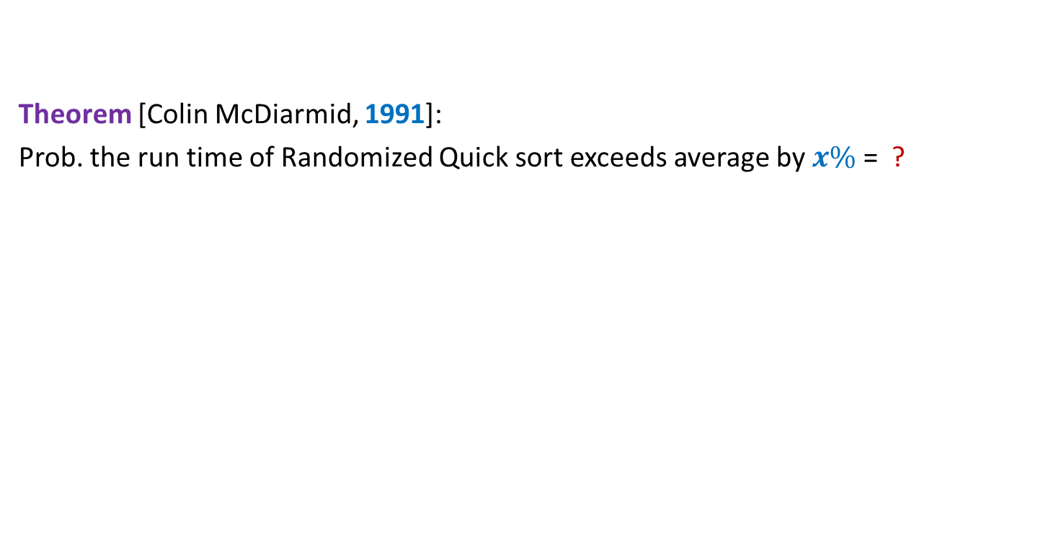










Contract($G,e$)
$$u$$
$$x$$
$$a$$
$$l$$
$$v$$
$$y$$
$$b$$
$$h$$
$$w$$
Contract($G,(x,y))$
$$u$$
$$a$$
$$l$$
$$v$$
$$xy$$
$$b$$
$$h$$
$$w$$

Slide 9
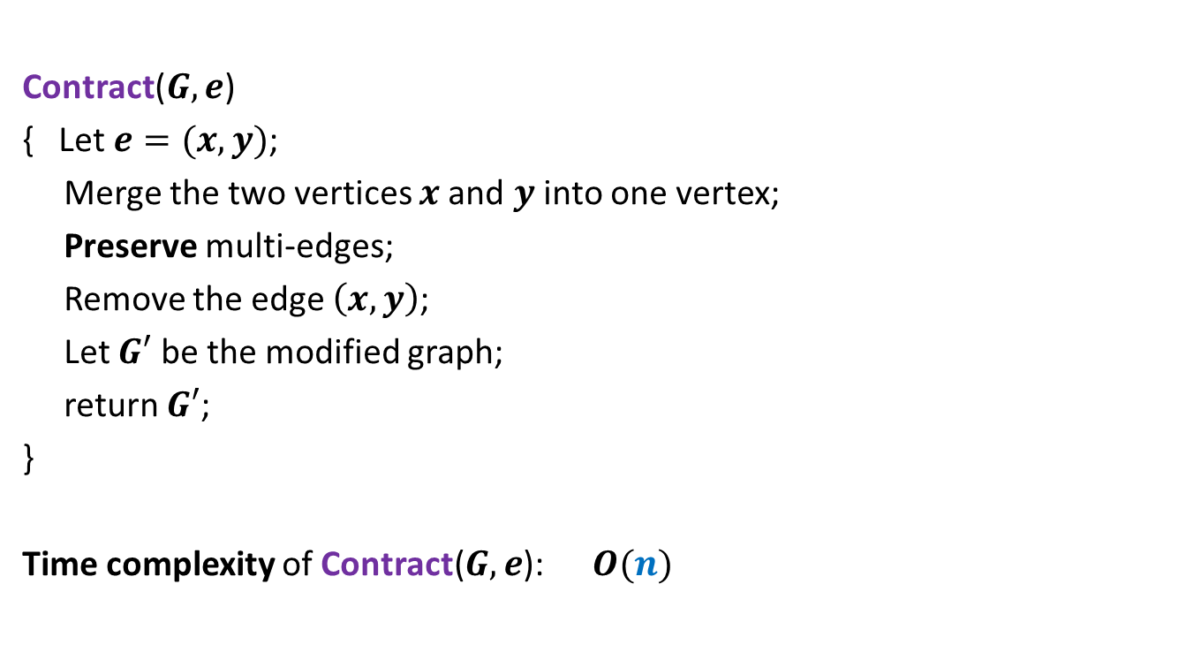

Contract($G,e$)
Contract($G,e$)
{ Let $e=(x,y)$;
Merge the two vertices $x$and $y$ into one vertex;
Preserve multi-edges;
Remove the edge $\left(x,y\right)$;
Let $G′$ be the modified graph;
return $G′$;
}
Time complexity of Contract($G,e$): $O(n)$

Slide 10

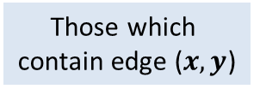


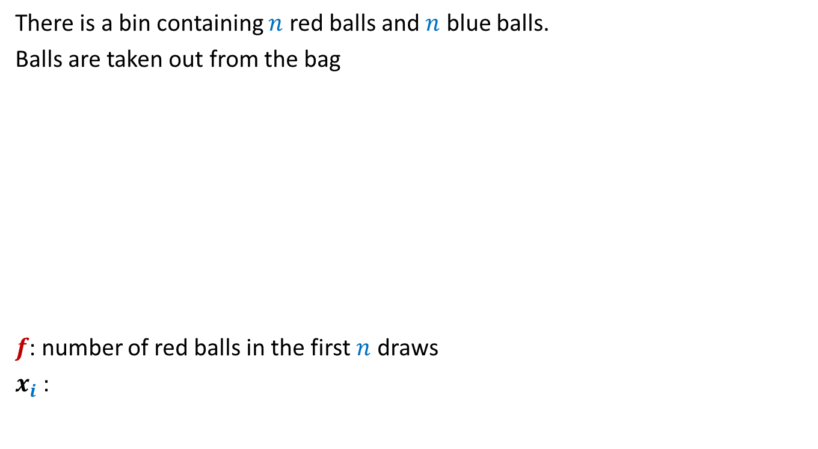
Contract($G,e$)
$$u$$
No
$$x$$
$$a$$
$$l$$
$$v$$
$$y$$
$$b$$
$$h$$
$$w$$
Contract($G,(x,y))$
$$u$$
$$a$$
$$l$$
$$v$$
$$xy$$
$$b$$
$$h$$
$$w$$
Which cuts of $G$ are absent from $G′$ ?
Is a cut of $G$ also a cut of $G′$ ?
Observation:
Every cut of $G′$ is also a cut of $G$.
$$G′$$
Those which
contain edge ($x,y$)
Yes
Yes

Slide 11

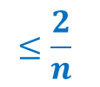
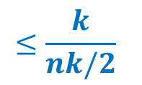
Contract($G,e$)
Let $k$ be the size of min-cut of $G$.
Let $C$ be any min-cut of $G$.
Let $G′$ be the graph after Contract($G,e$).
Question: Under what circumstance will $C$ be a cut of $G′$ ?
Answer: if $e∉C$.
Question: If $e$ is selected randomly uniformly,
what is the probability that $C$ is absent from $G′$ ?
Answer: $\frac{k}{m}$
$$≤\frac{k}{nk/2}$$
$$≤\frac{2}{n}$$

Slide 12

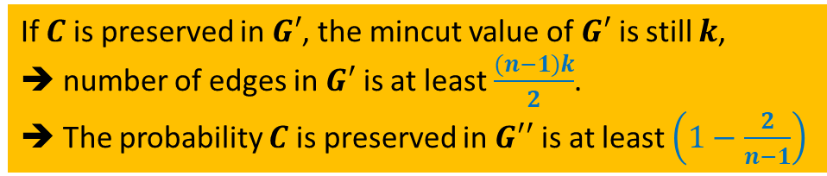
Contract($G,e$)
Let $k$ be the size of min-cut of $G$.
Let $C$ be any min-cut of $G$.
Lemma: If edge $e$ to be contracted is selected randomly uniformly,
$C$ is preserved with probability at least $1−\frac{2}{n}$.
Let $e∈_{r}G$;
$G′$ ← Contract($G,e$).
Let $e′∈_{r}G′$;
$G′′$ ← Contract($G′,e$).
Question: What is probability that $C$ is preserved in $G′′$ ?
Answer:$\left(1−\frac{2}{n}\right).\left(1−\frac{2}{n−1}\right)$
If $C$ is preserved in $G′$, the mincut value of $G′$ is still $k$,
➔ number of edges in $G′$ is at least $\frac{(n−1)k}{2}$.
➔ The probability $C$ is preserved in $G′′$ is at least $\left(1−\frac{2}{n−1}\right)$
Let us apply one more contraction step.
Can you design the algorithm now ?

Slide 13


Algorithm for min-cut
Min-cut($G$):
{ Repeat ?? times
{
Let $e∈_{r}G$;
$G$ ← Contract($G,e$).
}
return the edges of multi-graph $G$;
}
Running time: $O(n^{2})$
$$n−2$$

Slide 14
3
1
3
1
5
5
2
2
4
4
1
1
3,4
3,4
Sample executions
5
5
2
2
1
3,4,5
1
,3,4
2
5
2
1,2,3,4
1
2,3,4,5
5
Success ☺
Failure ☹

Slide 15

Algorithm for min-cut
Question: What is probability that $C$ is preserved during the algorithm ?
Answer: $\left(1−\frac{2}{n}\right).\left(1−\frac{2}{n−1}\right).\left(1−\frac{2}{n−2}\right)…\frac{3}{5}.\frac{2}{4}.\frac{1}{3}$
= $\left(\frac{n−2}{n}\right).\left(\frac{n−3}{n−1}\right).\left(\frac{n−4}{n−2}\right)…\frac{3}{5}.\frac{2}{4}.\frac{1}{3}$
= $\frac{2}{n}.\frac{1}{n−1}$
>$\frac{1}{n^{2}}$
How to increase the success probability ?

Slide 16
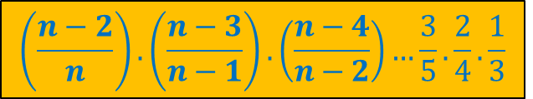
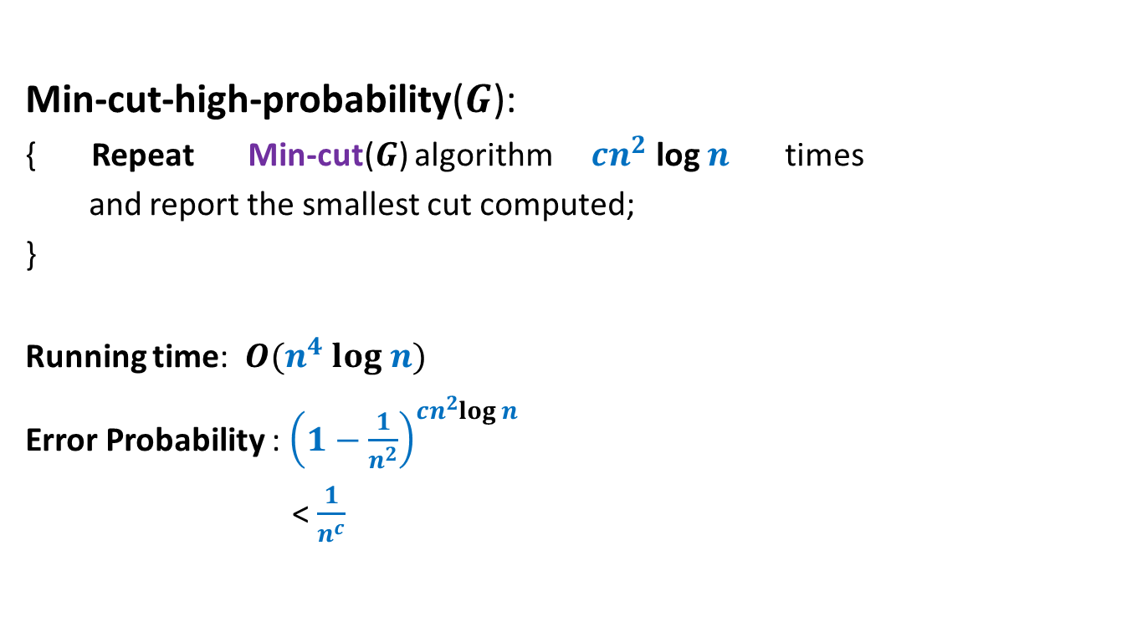
Algorithm for min-cut
Min-cut-high-probability($G$):
{ Repeat Min-cut($G$) algorithm $cn^{2}$ log $n$ times
and report the smallest cut computed;
}
Running time: $O(n^{4} log n)$
Error Probability : ${\left(1−\frac{1}{n^{2}}\right)}^{cn^{2}log n}$
< $\frac{1}{n^{c}}$
$$\left(\frac{n−2}{n}\right).\left(\frac{n−3}{n−1}\right).\left(\frac{n−4}{n−2}\right)…\frac{3}{5}.\frac{2}{4}.\frac{1}{3}$$

Slide 17
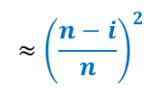
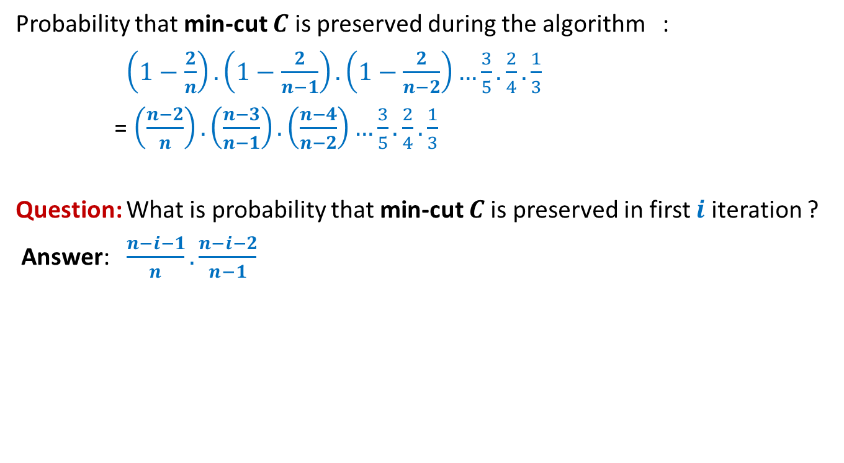
Algorithm for min-cut
Probability that min-cut $C$ is preserved during the algorithm :
$\left(1−\frac{2}{n}\right).\left(1−\frac{2}{n−1}\right).\left(1−\frac{2}{n−2}\right)…\frac{3}{5}.\frac{2}{4}.\frac{1}{3}$
= $\left(\frac{n−2}{n}\right).\left(\frac{n−3}{n−1}\right).\left(\frac{n−4}{n−2}\right)…\frac{3}{5}.\frac{2}{4}.\frac{1}{3}$
Question: What is probability that min-cut $C$is preserved in first $i$ iteration ?
Answer: $\frac{n−i−1}{n}.\frac{n−i−2}{n−1}$
$$≈{\left(\frac{n−i}{n}\right)}^{2}$$

Slide 18


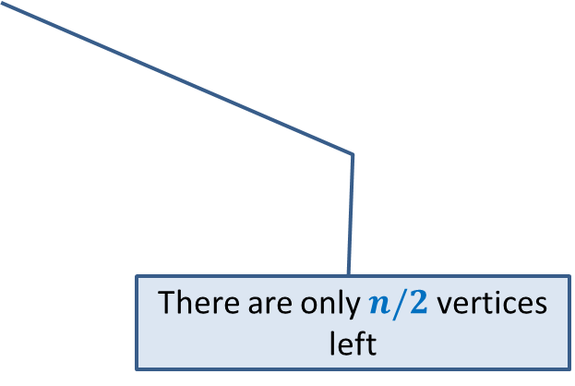
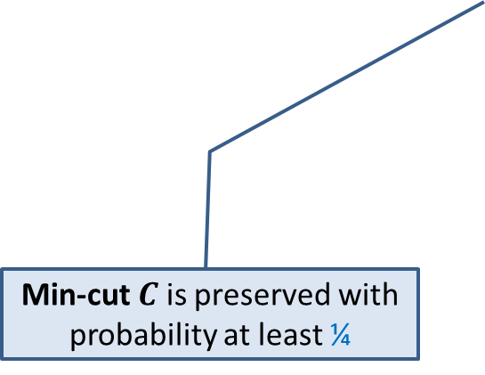
Key observations about Min-Cut algorithm
Algorithm performs $n−2$ contractions :
$$n/2$$
Min-cut $C$ is preserved with probability at least ¼
There are only $n/2$ vertices left
How to exploit these two observations ?
Homework: Ponder over this question before coming to next lecture.

Slide 19
Helping Ram distribute the apple among two friends
Using least no. of random bits.

Slide 20

An illustrative example
$$k=3$$
$p=\frac{5}{8}$, and
$1−p=\frac{3}{8}$
Homework in the past
Expected number of bits =
$$\frac{7}{4}$$

Slide 21
The generic example
$p=\frac{α}{2^{k}}$ , $1−p=\frac{2^{k}−α}{2^{k}}$

Slide 22
How many random bits ?
Not needed
Without loss of generality assume that $α<2^{k−1}$.
$$1$$ | $$1$$ | $$0$$ | $$1$$ | $$0$$ | $$0$$ | $$0$$ | $$1$$
$$1 2 … k$$
Shyam
Kabir
$$0$$
$$α−1$$
$$2^{k−1}−1$$
$$2^{k}−1$$
$$0 0 0…0$$
$$0 1 1…1$$
$$1 1 1…1$$
$k0$’s
$(k−1)1$’s
$$k{ 1}^{′}s$$
If the Most Significant Bit is $1$,
do we need other bits of the number ?
Suppose a random $k$-bit number is generated.

Slide 23


How many random bits ?
B($α,k$) : Expected number of bits to divide with parameters $p=\frac{α}{2^{k}}$
B($α, k$) = $1 + \frac{1}{2}⋅0 +\frac{1}{2}⋅$
= $1+\frac{1}{2}⋅$ B($α,k−1$)
$$0$$
$$1 2 … k$$
$$0$$
$$α−1$$
$$2^{k−1}−1$$
$$0 0 0…0$$
$$0 1 1…1$$
$$1 1 1…1$$
$$k−1$$
$$k$$
If the Most Significant Bit is $0$,
do we need other bits of the number ?
B($α,k−1$)
Yes, indeed.
$$<2$$
But problem now reduces to a smaller problem.
Think over it before pressing next button...

Slide 24

Computing a random sample of size $k$from [$0,n−1$]
In an efficient manner.

Slide 25


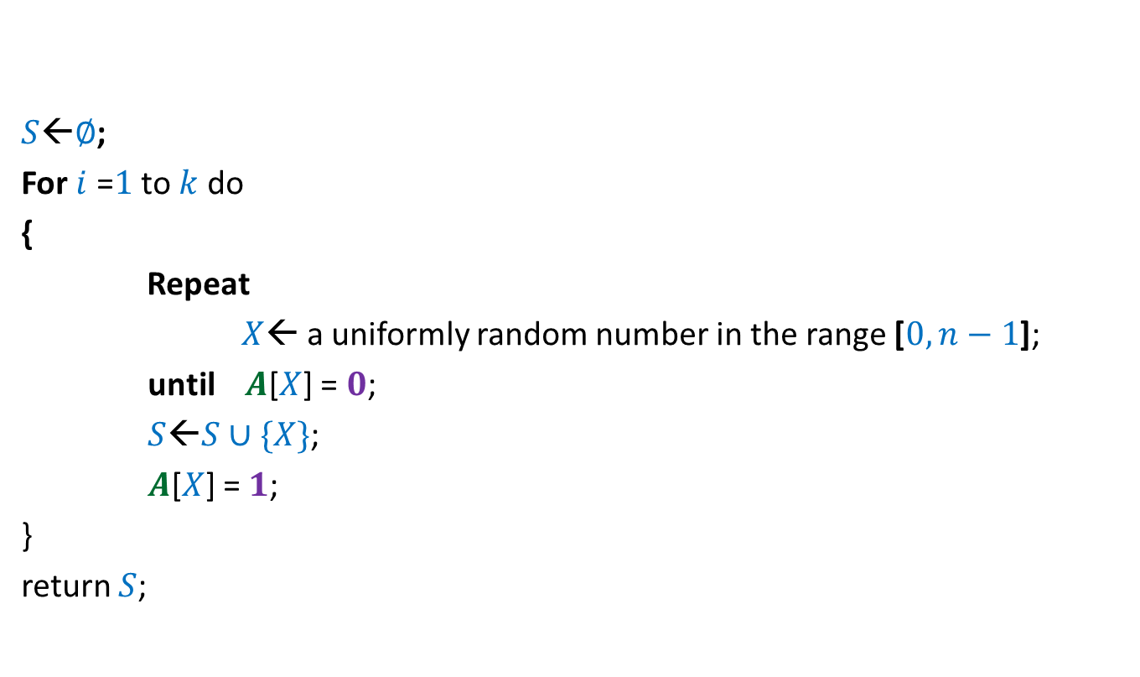



$$0$$ | $$0$$ | $$0$$ | $$0$$ | $$0$$ | $$0$$ | $$0$$ | $$0$$
$$A$$
$$1$$
$$1$$
$$1$$
$$1$$
$S$←$∅$;
For $i$ =$1$ to $k$ do
{
Repeat
$X$← a uniformly random number in the range [$0,n−1$];
until $A$[$X$] = $0$;
$S$←$S∪\{X\}$;
$A$[$X$] = $1$;
}
return $S$;
$$0 1 … n−1$$
Homework: What is the expected no. of random bits needed ?

Slide 26

Computing a random permutation of [$0,n−1$]
In an efficient manner.

Slide 27

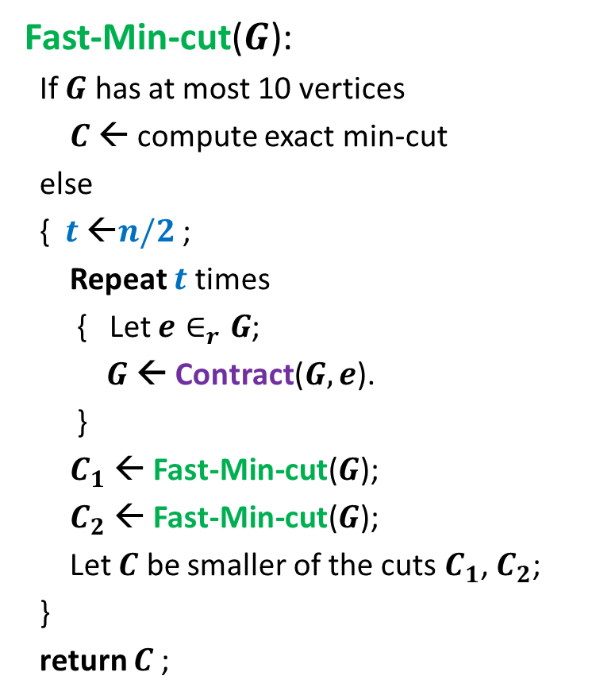

$$0$$ | $$0$$ | $$0$$ | $$0$$ | $$0$$ | $$0$$ | $$0$$ | $$0$$
$$A$$
$$1$$
$$1$$
$$1$$
$$1$$
$$1$$
$$1$$
$S$←empty string;
For $i$ =$1$ to $n$ do
{
Repeat
$X$← a uniformly random number in the range [$0,n−1$];
until $A$[$X$] = $0$;
$S$←$S∷X$;
$A$[$X$] = $1$;
}
return $S$;
$$0 1 … n−1$$
Homework: What is the expected no. of random bits used ?
Homework: Can you reduce the number random bits used ?

